Slide 1
Improving
Commuter Awareness in Subway Delays
UofT SSDS Datathon 2025
Charlize, Kitas, Vincent, Shamim

Slide 2
Table of contents
01
02
03
04
TTC Subways
Data at a Glance
Our Algorithm
What’s Next

Slide 3
01
TTC Subways
Why do delays occur?

Slide 4
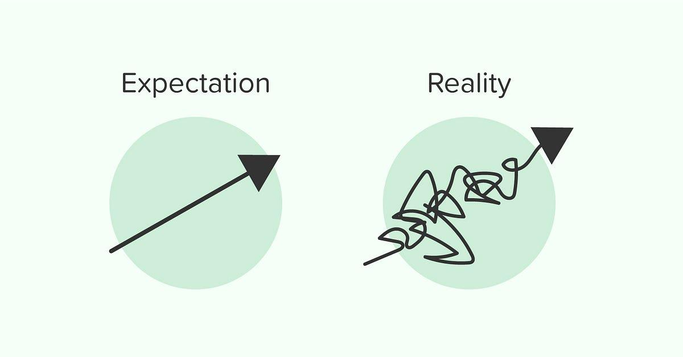
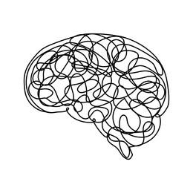
The Issue at Hand
Random delays are one the most notorious aspects of taking public transit and TTC is no stranger to subway delays.
TTC riders suffer from experiencing:
Frequent and unexpected delays
Lack of transparency on estimated delay time
These factors cause make it difficult to manage expectations around travel time, creating public distrust in the TTC.

Slide 5
02
Data at a Glance
What do the statistics show?

Slide 6
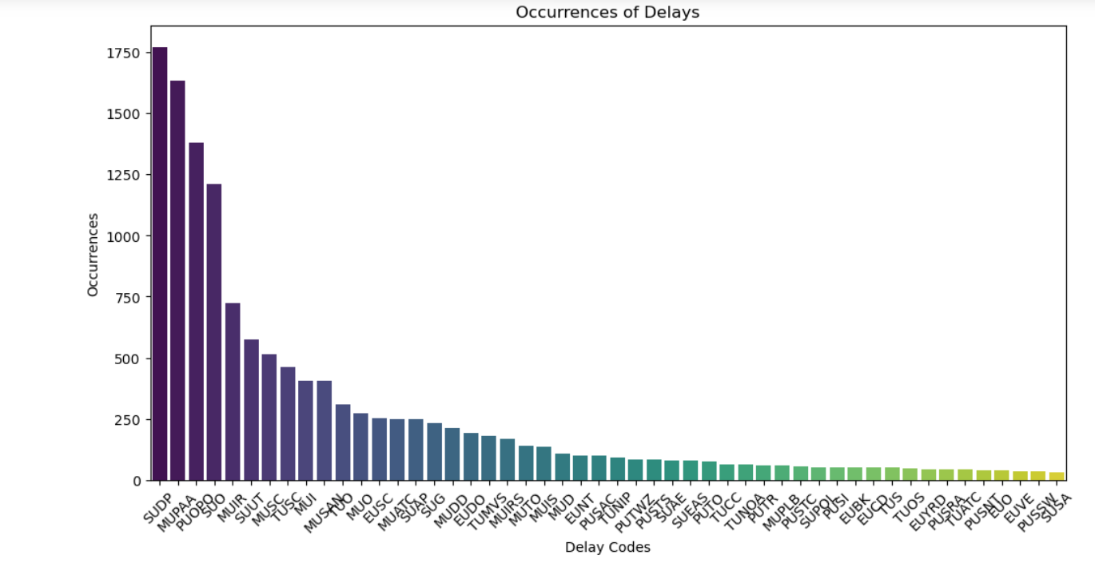
Most Common Subway Delays
Notes:
Most Common Delay time: 3 mins
Delay Codes:
SUDP
Disorderly Passenger
MUPAA
Passenger Assistance
Alarm Activation
PUOPO
Train door monitoring

Slide 7
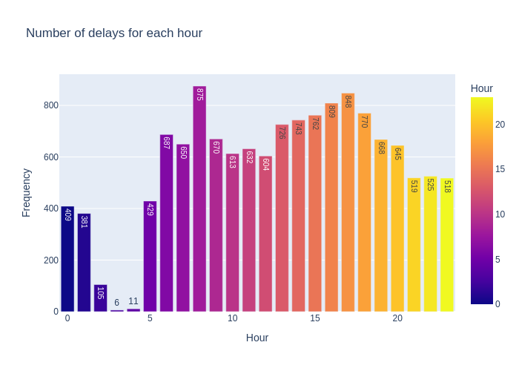
Most Common Subway Delays
Notes:
Most Common Delay time: 3 mins
Delay Codes:
SUDP
Disorderly Passenger
MUPAA
Passenger Assistance
Alarm Activation
PUOPO
Train door monitoring

Slide 8
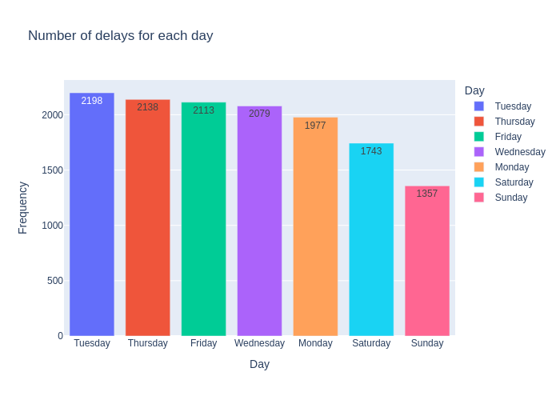
Most Common Subway Delays
Notes:
Most Common Delay time: 3 mins
Delay Codes:
SUDP
Disorderly Passenger
MUPAA
Passenger Assistance
Alarm Activation
PUOPO
Train door monitoring

Slide 9
03
Our Algorithm
What does our model do?

Slide 10



Introducing:
TTC Above or Below
Above or Below is an algorithm designed to help commuters assess whether a subway delay is worth sticking around for.
Easy interpretability
Accurate Predictions
Machine Learning predictions based on real time trends

Slide 11
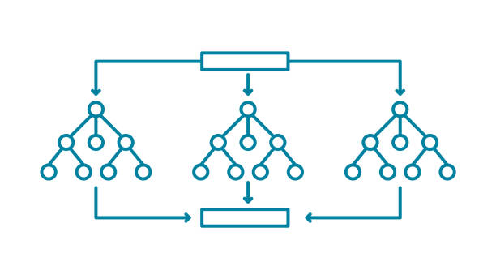
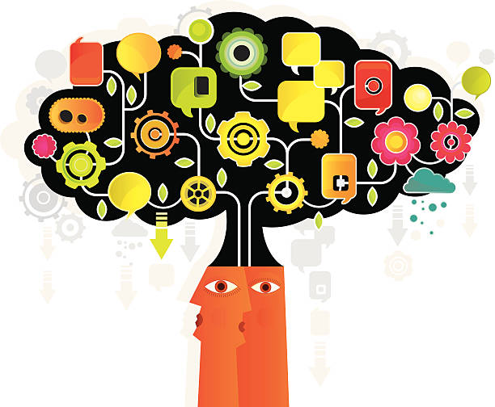
How does the Algorithm Work?
The Above or Below Algorithm is trained on TTC’s 2024 subway delay data. It utilizes various inputs such as cause of error and subway location to predict if the delay will be severe
The usage of Random Forest Classification Tree in our model ensures higher degree of predictability and prevents excessive overgeneralization of trends.

Slide 12
04
What’s Next
Why do delays occur?

Slide 13
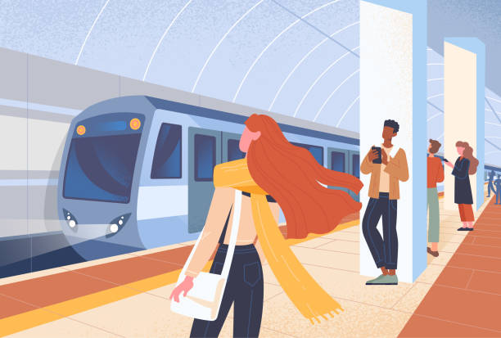
Why should you use it?
Managing expectations of subway delays
The goal of this algorithm is to spread commuter awareness within the GTA
Bringing attention to the value of sharing public knowledge

Slide 14
Thanks!
Do you have any questions?
Please keep this slide for attribution

